Slide 1
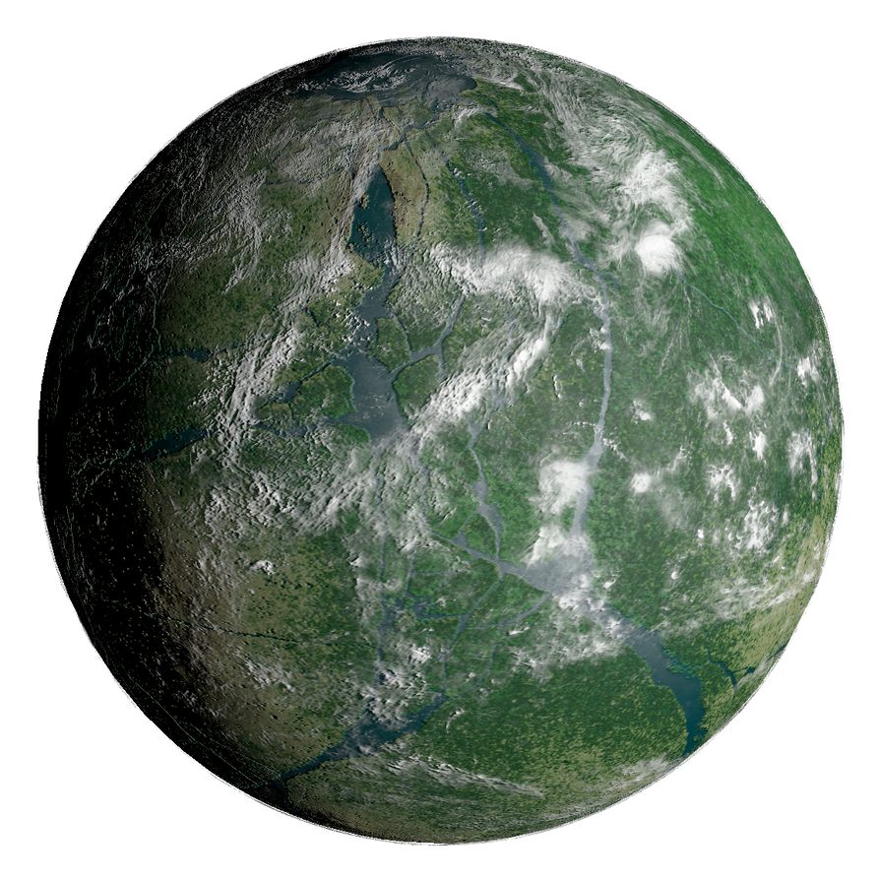
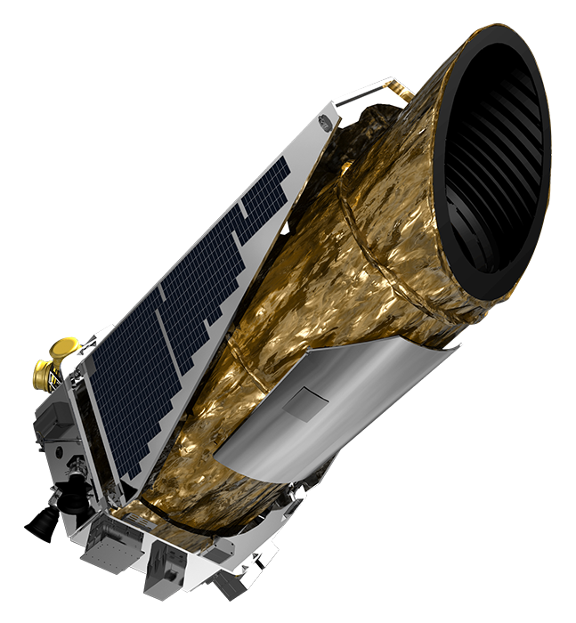
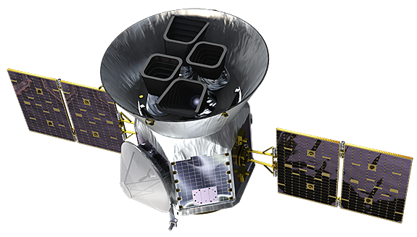

A World Away: Hunting for Exoplanets with AI
Astronomically Better
Mario, Erasmo, Ethan, Matus

Slide 2
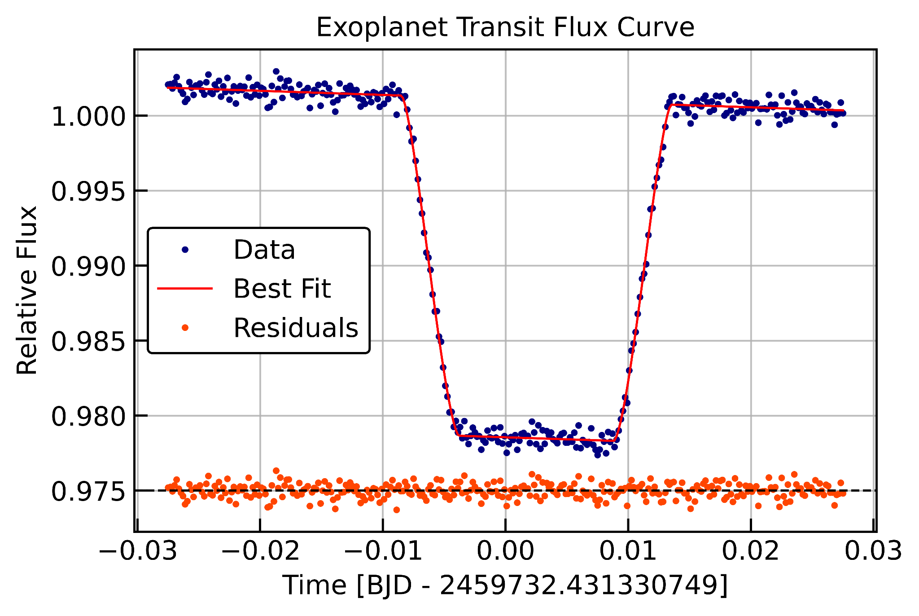
Exoplanet Basics
Detection:
Planet passes in front of star
Dip in luminosity
Get planet radius and orbital period from flux curve
https://astronomy.stackexchange.com/questions/41337/exoplanet-dip-in-transit-light-curve-when-the-planet-passes-behind-the-star

Slide 3
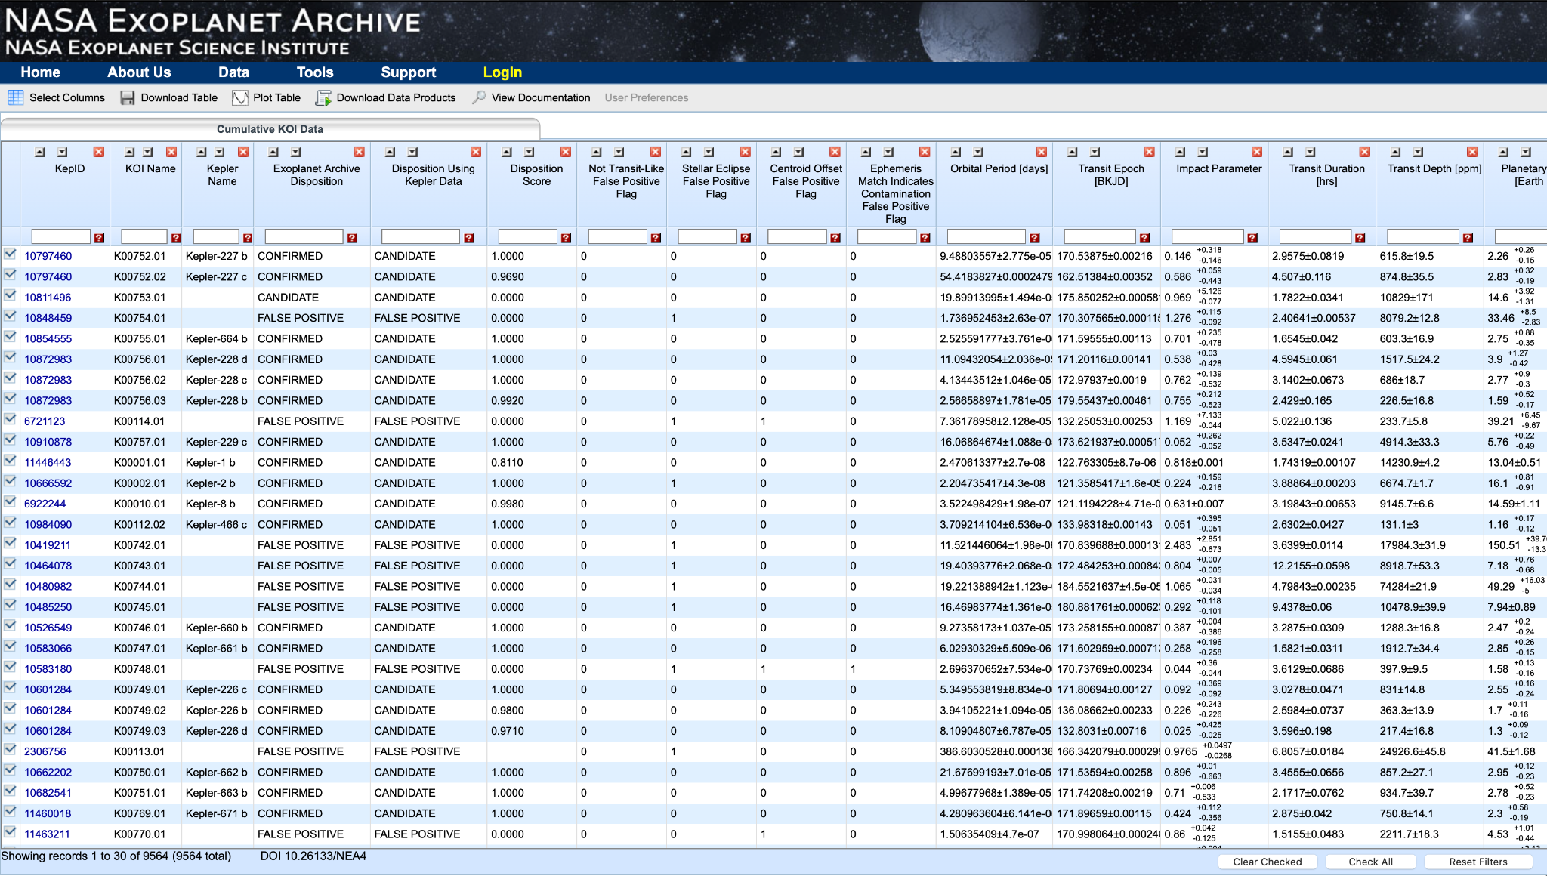
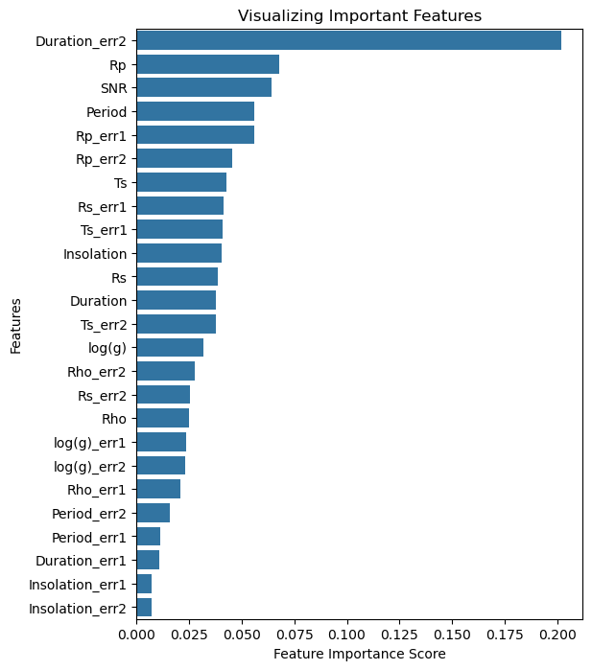
Use of AI/ML for faster detection
Why?
Quickly separate actual exoplanets from noise
Random Forest model
* Based on https://github.com/thiagosfluz/Exoplanet_classification/blob/main/random-forest-exoplanet.ipynb

Slide 4
Website
Input a .csv file with exoplanet candidate data (eg. Kepler)
Python preprocessing to select and rename relevant columns
Output an updated .csv with predictions in “id, pred, confidence” format
Use Hugging Face python backend to run pretrained model on .csv
Give visualisations of Random Forest Classifier ran on your dataset

Slide 5
Demo Video

Slide 6
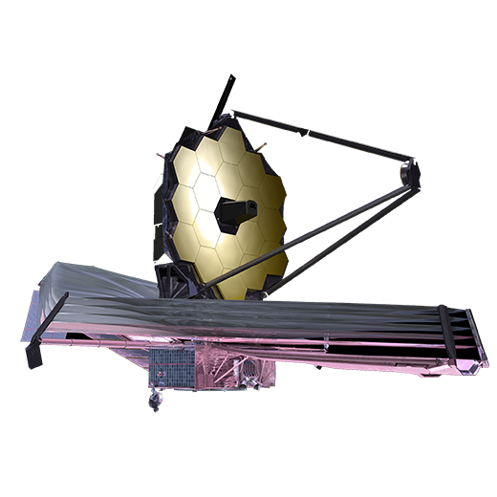
What’s next?
Accept more variability of .csv files with different columns.
Better deal with missing data (NaN’s and/or 0’s)
Automation (reduce steps to run model on dataset)
Continuous training of model with new datasets being added
Improve website UI
Provide more scientific insight with output data
fabeloom@tcd.ie, marcozze@tcd.ie, nolanrae@tcd.ie, starcok.m@ tcd.ie

